Slide 1

EXPERT SYSTEM & ARCHITECTURE
SYED DANISH ALI-2K18CSUN01043
AMANPREET SINGH-2K18CSUN01008

Slide 2

ARCHITECTURE OF EXPERT SYSTEM .
INTRODUCTION.
HISTORY.
APPLICATIONS.
IN DEPTH KNOWLEDGE.
TYPES.
DEVLOPMENT LIFECYCLE.
ADVANTAGES & LIMITATIONS.

Slide 3

welcome
CREATED BY :- SYED DANISH ALI
AMANPREET SINGH

Slide 4

INTRODUCTION
An expert system , is an interactive computer-based decision tool that uses both facts and heuristics to solve difficult decision making problems , based on knowledge acquired from an expert.
Inference engine + Knowledge = Expert system (Algorithm +Data structures= Program in traditional computer)
First expert system , called DENDRAL ,was developed in the early 7o's at Stanford University.

Slide 5

BOOK DEFINITION
In artificial intelligence, an expert system is a computer system that emulates the decision-making ability of a human expert. Expert systems are designed to solve complex problems by reasoning through bodies of knowledge, represented mainly as if–then rules rather than through conventional procedural code.

Slide 6

H I S T O R Y O F E X P E R T S Y S T E M

Slide 7
The first expert systems were created in the 1970s and then proliferated in the 1980s. Expert systems were among the first truly successful forms of artificial intelligence (AI) software. Goal of Al scientists >develop computer programs that could in some sense think. In 60s>general purpose programs were developed for solving the classes of problems but this strategyproduced no breakthroughs. In 1970>it was realized that The problem-solving power of program comes from the knowledge it possesses.
HISTORY

Slide 8

APPLICATIONS
Expert systems are computer applications which embody some non-algorithmic expertise for solving certain types of problems.
.
Application | Description
Design Domain | Camera lens design, automobile design.
Medical Domain | Diagnosis Systems to deduce cause of disease from observed data, conduction medical operations on humans.
Monitoring Systems | Comparing data continuously with observed system or with prescribed behavior such as leakage monitoring in long petroleum pipeline.
Process Control Systems | Controlling a physical process based on monitoring.
Knowledge Domain | Finding out faults in vehicles, computers.
Finance/Commerce | Detection of possible fraud, suspicious transactions, stock market trading, Airline scheduling, cargo scheduling.

Slide 9
M O R E A B O U T A R C H I T E C T U R E OF E X P E R T S Y S T E M

Slide 10
.
Capabilities of Expert Systems :- The expert systems are capable of −
1.Instructing and assisting human in decision making. 2.Demonstrating. 3.Deriving a solution. 4.Diagnosing. 5.Explaining. 6.Interpreting input. 7.Predicting results. 8.Justifying the conclusion. 9.Suggesting alternative options to a problem. 10. Advising.
.

Slide 11
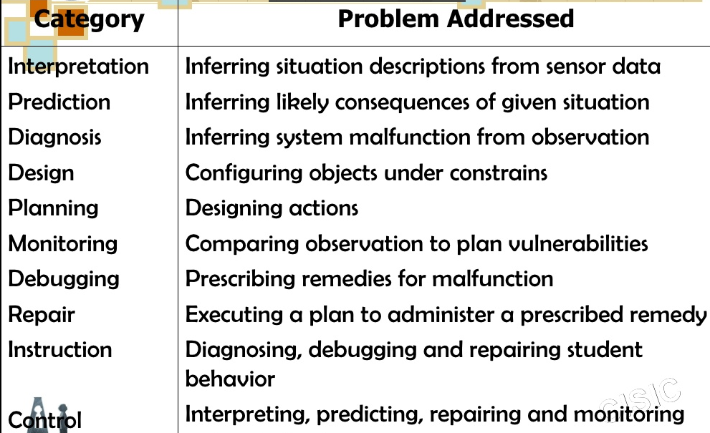

Slide 12
The components of ES include − Knowledge Base Inference Engine User Interface
…

Slide 13
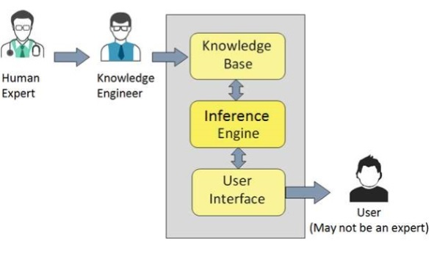
Let us see them one by one briefly −
…

Slide 14
**Knowledge Base It contains domain-specific and high-quality knowledge. Knowledge is required to exhibit intelligence. The success of any ES majorly depends upon the collection of highly accurate and precise knowledge. What is Knowledge? The data is collection of facts. The information is organized as data and facts about the task domain. Data, information, and past experience combined together are termed as knowledge
…

Slide 15
Components of Knowledge Base -
The knowledge base of an ES is a store of both, factual and heuristic knowledge.
Factual Knowledge − It is the information widely accepted by the Knowledge Engineers and scholars in the task domain.
Heuristic Knowledge − It is about practice, accurate judgement, one’s ability of evaluation, and guessing.

Slide 16
**Inference Engine
Use of efficient procedures and rules by the Inference Engine is essential in deducting a correct, flawless solution.
+ Brain of ES.
To recommend a solution, the Inference Engine uses the following strategies −
Forward Chaining
Backward Chaining

Slide 17
**user interface
User interface provides interaction between user of the ES and the ES itself. It is generally Natural Language Processing so as to be used by the user who is well-versed in the task domain. The user of the ES need not be necessarily an expert in Artificial Intelligence.

Slide 18
E X P E R T S Y S T E M A R C H I T E C T U R E
..

Slide 19
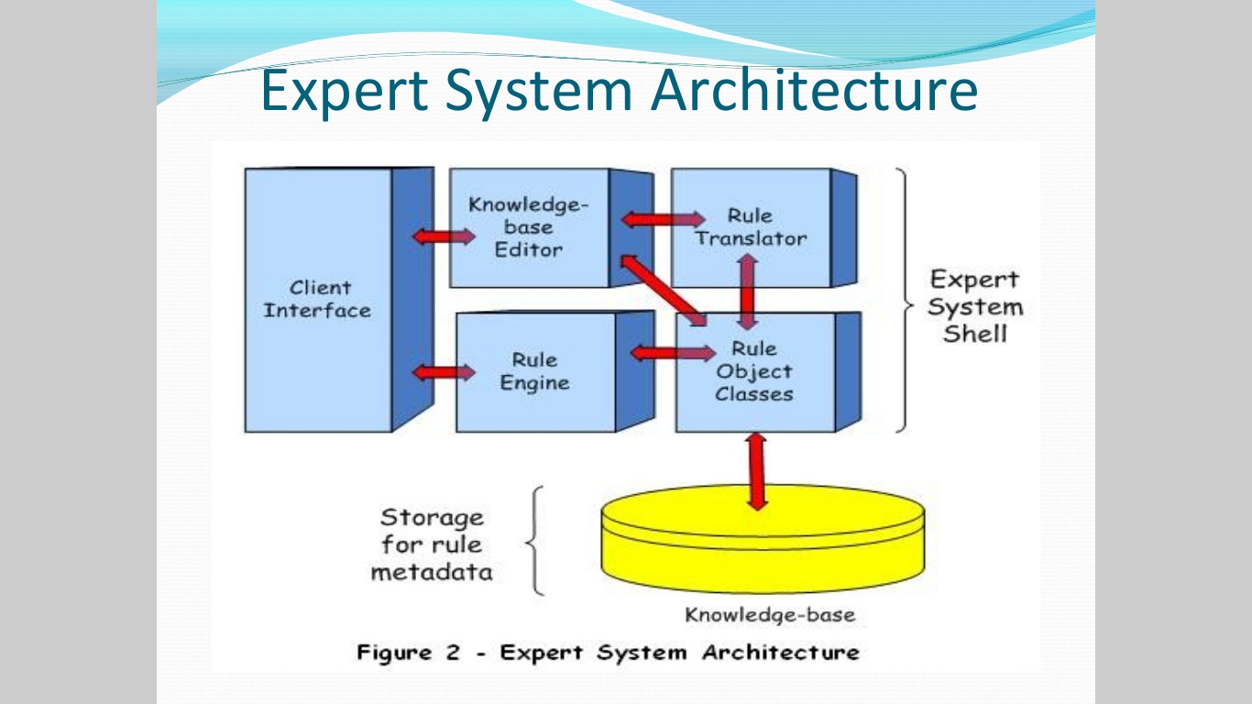
ARCHITECTURE OF EXPERT SYSTEM
..

Slide 20
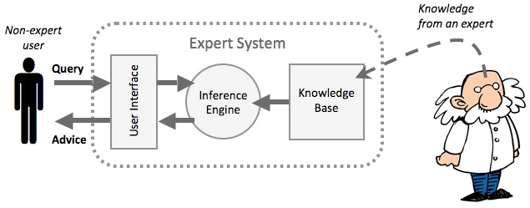
.
1.The Client Interface processes requests for service from system-users and from application layer components.
2.The Knowledge-base Editor is a simple editor that enable a subject matter expert to compose and add rules to the Knowledge-base.
3.Rule Translator converts rules from one form to another i.e;their original form to a machine-readable form.
4.The Rule Engine(inference engine)is responsible for executing Knowledge-base rules.
5.The shell component,Rule Object Classes,is a container for object classes supporting.

Slide 21

Development of Expert Systems
…

Slide 22
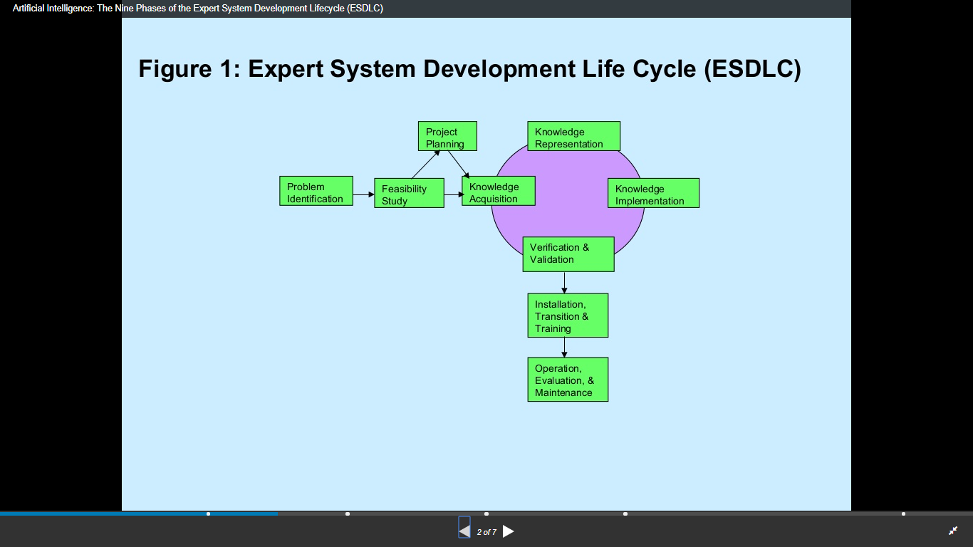
The process of ES development is iterative. Steps in developing the ES include −
Identify Problem Domain
Design the System
Develop the Prototype
Test and Refine the Prototype
Develop and Complete the ES
Maintain the System

Slide 23
EXPERT SYSTEM TECHNOLOGY
THERE ARE SEVERAL LEVELS OF ES TECH AVAILABLE
Expert systems technologies include −
Expert System Development Environment.
Tools.
Shells .

Slide 24

ADVANTAGE & LIMITATION
…

Slide 25
ADVANTAGES
Increased Output and Productivity
Decreased Decision Making Time
Increased Process and ProductQuality
Reduced Downtime
Capture Scarce Expertise
FlexibilityEasier
Equipment Operation Elimination of ExpensiveEquipment.
ETC..

Slide 26
LIMITATIONS
Knowledge is not always readily available Expertise can be hard to extract from humans.
Each expert's approach may be different , yet correct .
Hard , even for a highly skilled expert , to work under time pressure .
Expert system users have natural cognitive limits .
ES work well only in a narrow domain of knowledge.
ETC…

Slide 27
THANKS
CREATED BY:- DANISH ALI - 2K18CSUN01043
AMANPREET – 2K18CSUN01008
[CSE – 4C]

